Slide 1

Chapter 2
How to code, test,
and validate a web page

Slide 2
Objectives
The HTML syntax
The CSS syntax
How to use Brackets to work with HTML and CSS files
How to test, debug, and validate HTML and CSS files

Slide 3
The HTML Syntax

Slide 4
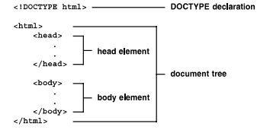
Basic structure of an HTML document
An HTML document contains HTML element that define the content and structure of a web page.
Notes:
Mô tả nội dung chi tiết từng chuyên đề

Slide 5
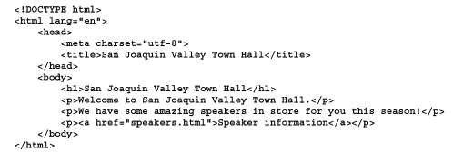
A simple HTML5 document

Slide 6


Code elements and tags
Most HTML element have an opening tag, content, and a closing tag. Each tag is coded within a set of brackets (<>)
Two elements with opening and closing tags
Two empty tags

Slide 7

Code elements and tags (cont.)
Correct and incorrect nesting of tags

Slide 8
How to code attributes
Attributes can be coded within opening or empty tags to optional values
Opening tag with attributes
One attribute:
<a href=“contact.html”>
Three attribute :
<a href=“contact.html” title=“Click to Contact Us” class=“nav_link”>

Slide 9
How to code attributes (cont.)
Empty tag with attributes:
<img src=“logo.gif” alt=“Murach logo”>
Boolean attribute:
<input type=“checkbox” name=“mailList” checked>
Common attributes for identifying HTML elements
Opening tag with an id attribute: <div id=“page”>
Opening tag with a class attribute:
<a href=“contact.html” title=“Click to Contact Us” class=“nav_link”>

Slide 10
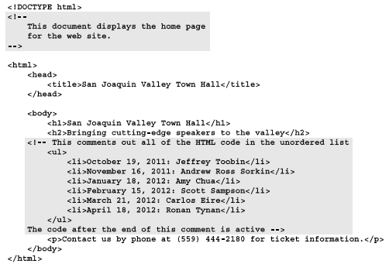
Comments and whitespace
An HTML comment is text that appears between the <!– and → characters.

Slide 11
The CSS Syntax

Slide 12
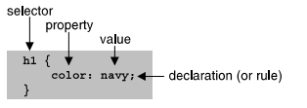
CSS rule sets and comments
A CSS rule set consist of a selector and a declaration block.
A seclector consist of the identifiers that are at the beginning of the rule set.

Slide 13
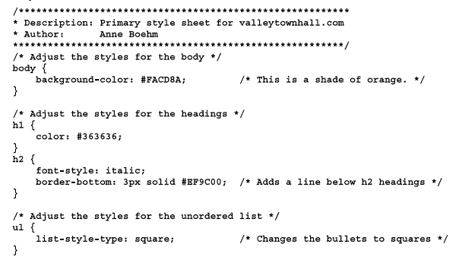
CSS rule sets and comments
CSS comments begin with the characters /* and end characters */.
A CSS comment can be coded on a single line, or it can multiple lines.

Slide 14
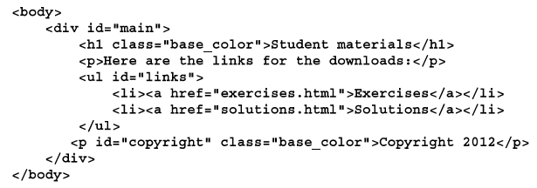
Basic selector
- HTML elements that can be selected by element type, id or class

Slide 15
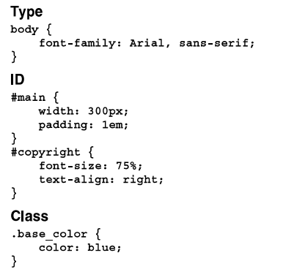
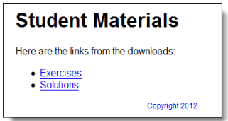
Basic selector
- CSS rule sets that select by element type, id and class
The element in a browser

Slide 16
How to use Visual Studio Code
to work with HTML and CSS files

Slide 17
Visual Studio Code
Visual Studio Code, also commonly referred to as VS Code, is a source-code editor made by Microsoft
VS code works well with Windows, Linux and Mac OS.
Features include support for debugging, syntax, highlighting, intelligent code completion, snippets, code refactoring and embedded Git.
Users can change the theme, keyboard shortcuts, preferences, and install extensions that add functionality.

Slide 18
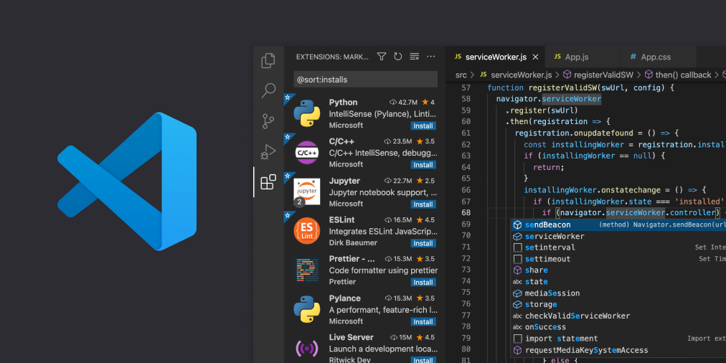
Visual Studio Code (cont.)
You can get VS code at: https://code.visualstudio.com/

Slide 19
How to use Visual Studio Code to work with HTML and CSS files
Open and close the folder for a website
Open, close and display files
Start new HTML file
Edit an HTML file
Start and edit a CSS file
Preview an HTML file

Slide 20
How to test, debug
and Validate HTML and CSS files

Slide 21
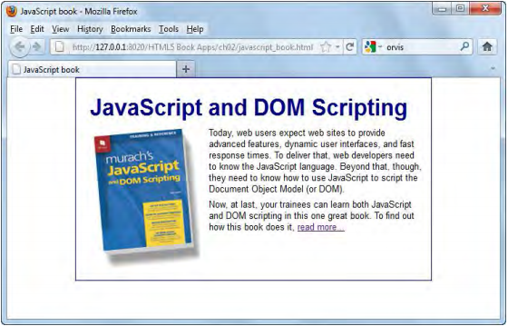
Test and debug a web page
The HTML file displayed in the Firefox browser

Slide 22
Test and debug a web page (cont.)
Three way to run a web page that’s on an intranet or your own computer
Browser
Window system
Brackets
Rerun a web page from a browser after you change it source code
Test a web page
Debug a web page

Slide 23
Validate an HTML file
To validate the HTML for a page, you can use program or website for that purpose. One of the most popular web sites is the W3C Markup Validation Service.
Use the W3C Markup Validation Service:
http://validator.w3.org/
Validate an HTML file from Aptana
Commands -> HTML -> Validate Syntax (W3C)

Slide 24
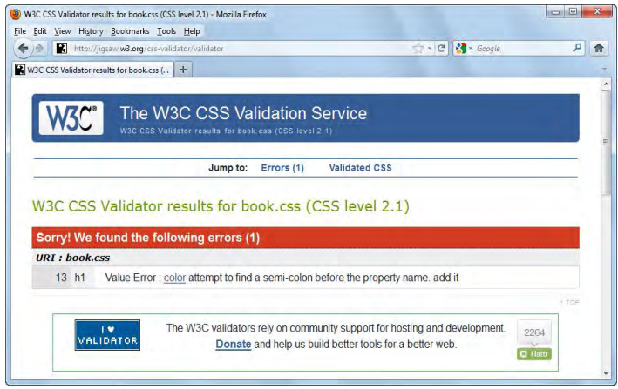
Validate a CSS file
- The CSS validation Service with errors displayed.

Slide 25
Validate a CSS file
Use the W3C CSS Validation Service
http://jigsaw.w3.org/css-validator/
Validate a CSS file from Aptana
Commands -> CSS -> Validate Selected CSS (W3C) command.

Slide 26
Summary
HTML document, syntax, attribute
CSS rule set, Selector, comment work like HTML document
Test and run HTML file on browser
Validate an CSS or HTML file
Notes:
Tóm tắt lại nội dung đã học

Slide 27
Discussion
Why we should use CSS for web page?
Notes:
Trả lời câu hỏi WHY?

